Slide 1

DH
DH TEAM
PRESENT
NOTECHAIN
PRESENTATION
CREATED BY DH TEAM
NOTECHAIN4ALL.COM

Slide 2


01
DH
BACKGROUND
One problem that has plagued the music industry is the legitimacy of ownership, which causes a lot of problems, such as false copyrighting without actual proof of ownership in videos, or even claims of plagiarism.

Slide 3

02
DH
WHAT?
is the problem
MAIN
GLOBAL COPYRIGHT DIFFERENCES (DIFFICULTY IN ENSURING COPYRIGHT PROTECTION GLOBALLY)
SUB
METADATA ISSUES (MISSING DATA CAN HINDER THE PAYMENT PROCEDURE OF ARTISTS)
SUB
SAMPLING AND INTERPOLATION (DECIDING AT WHICH POINT ONE IS CONSIDERED SAMPLING AND WHICH IS CONSIDERED PLAGIARISM)

Slide 4

03
DH
OUR SOLUTION?
Using our knowledge of the unique properties of the blockchain, we’d hope to create an ID system that is unique to that piece of music, in which it can’t be duplicated or fabricated.
Unlike record labels, NoteChain aims to unify the indexing of music to a decentralize, transparent, and immutable blockchain platform globally.

Slide 5

04
DH
PROBLEM:
METADATA ISSUES
Metadata, the essential information about a musical work, plays a pivotal role in the music industry.
Accurate metadata, including song titles, artist names, ISRC (International Standard recording Code), and composer details, is crucial for identifying rights holders and ensuring correct royalty distribution.

Slide 6

05
DH
PROBLEM:
SAMPLING AND INTERPOLATION
Notechain provides an audio fingerprinting system that shows similar songs in it’s directory, it is used as a security measure, in attempt to prevent fully plagiarized songs to enter the Notechain’s ecosystem

Slide 7
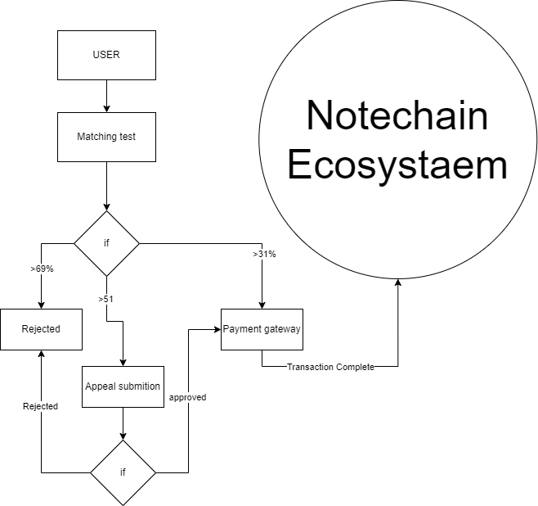
07
DH TEAM
SIMPLE ILLUSTRATION

Slide 8
DH
THANK YOU
+6285175196248
NOW
NOTECHAIN4ALL.COM

